Slide 1
Blockchain
Introduction to financial and technical aspects of blockchain technology – from basics to DeFi & NFT
2022/07 – Ralf Schwoebel
www.envoverse.com

Slide 2
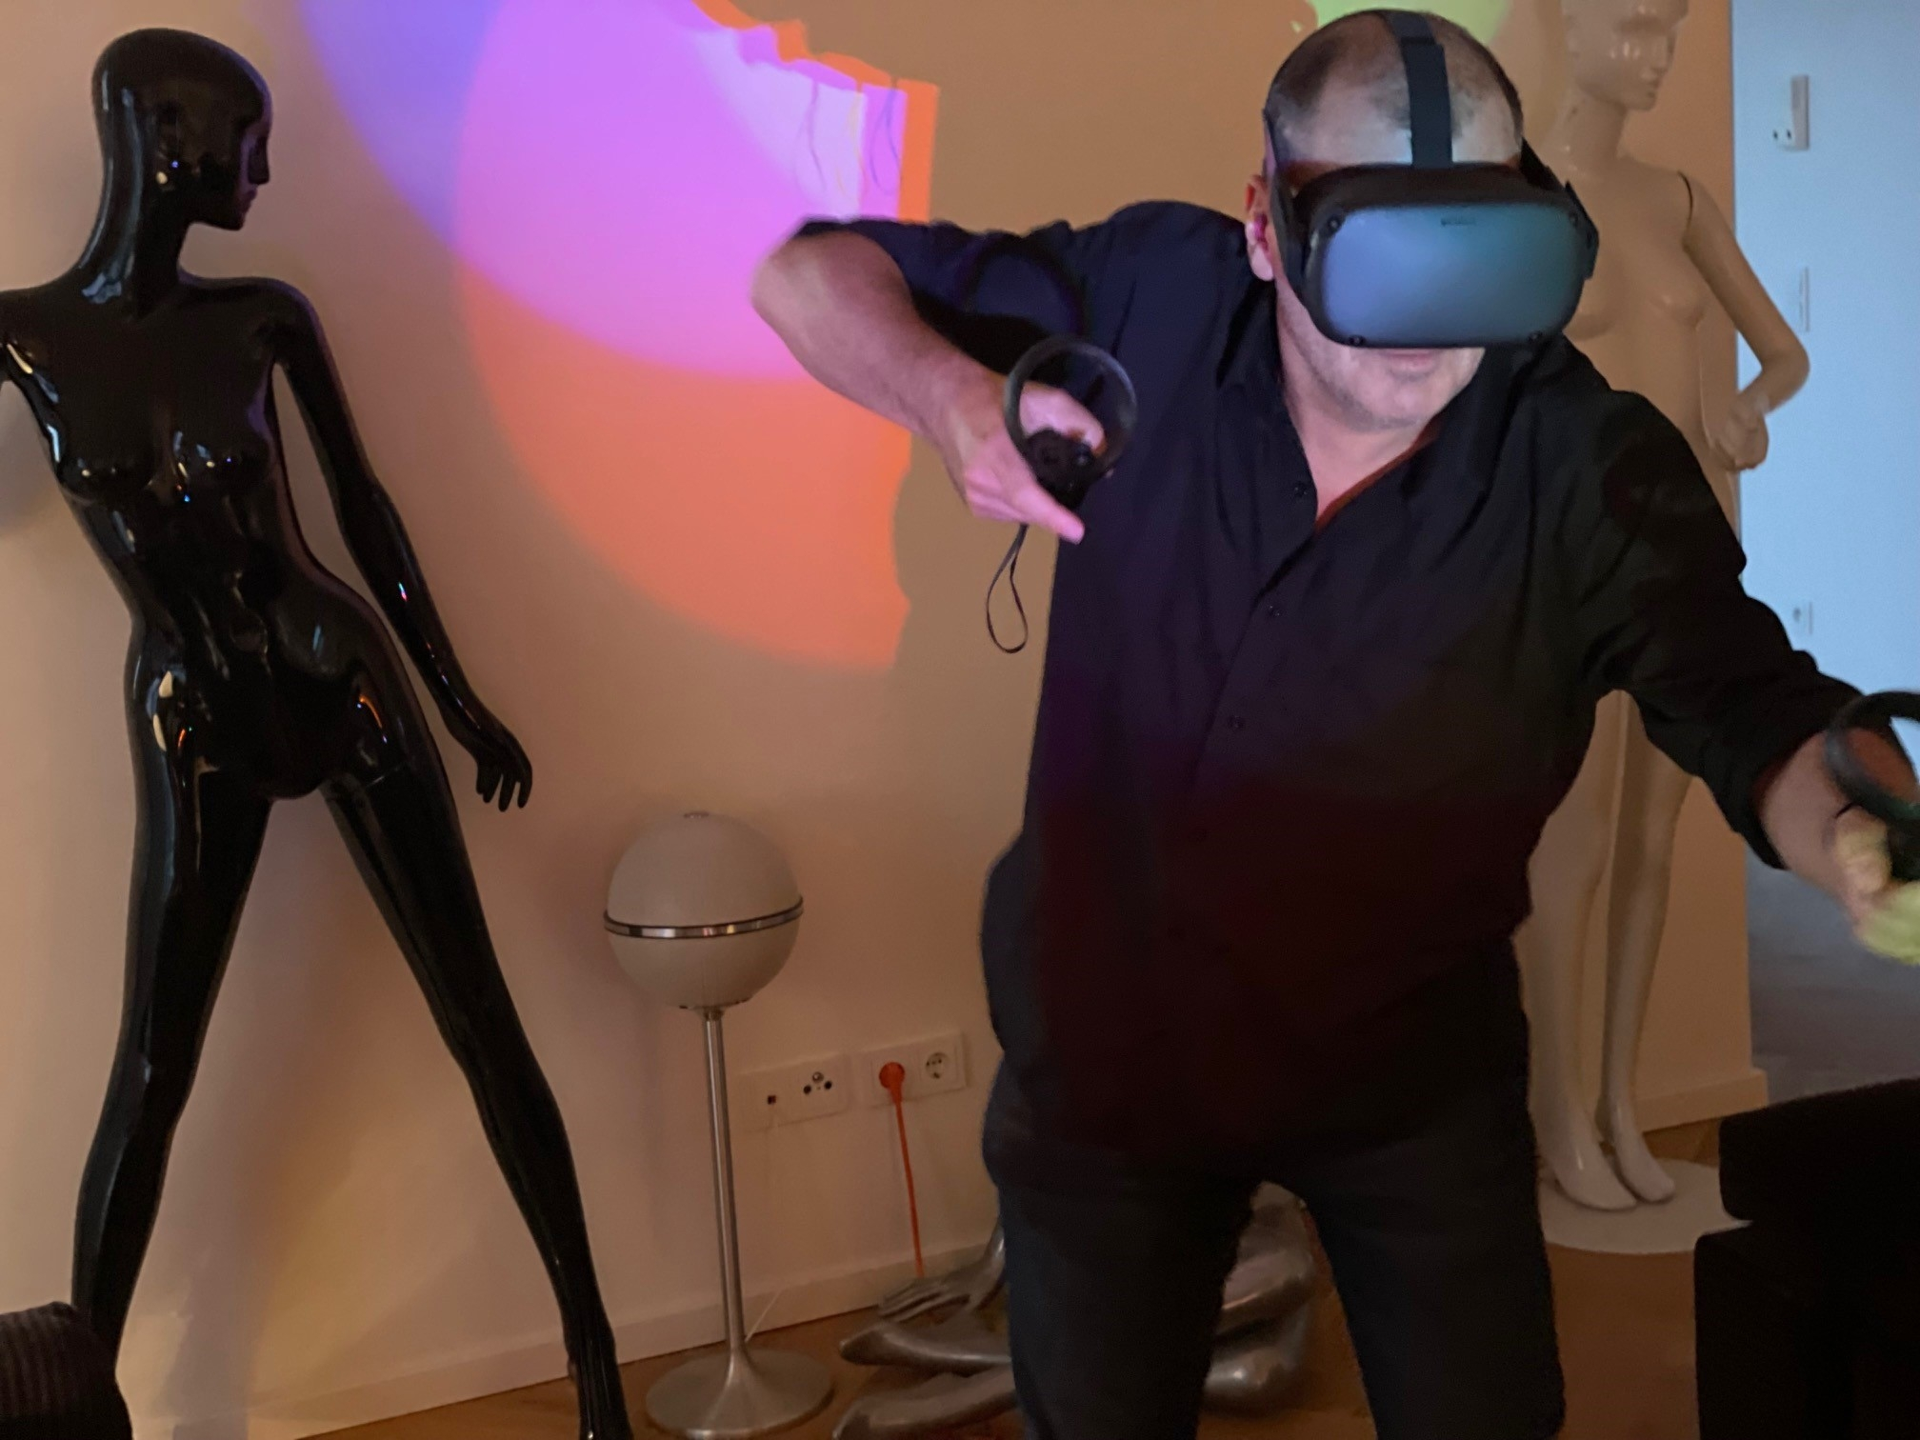
Hi, I am Ralf!
Started with game development in 1987
Self-employed since 1995
Created, changed or updated over 400 websites, shops and apps in 27 years
Built a platform for downloads and sold it in 2015 (first integration of Bitcoin payment)
www.metadist.de

Slide 3
Table of content
Introduction
Blockchain – simpler than you think
Financial disruption
Applications „on chain“

Slide 4
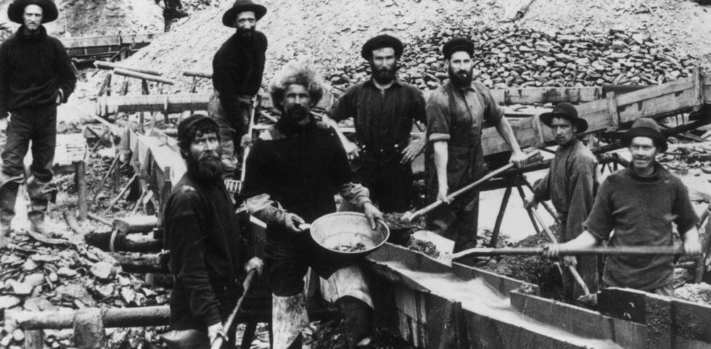
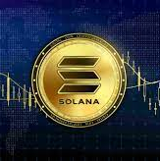
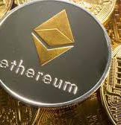
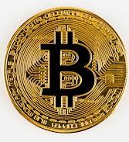
Intro: What is going on?
Digital currencies based on blockchain technology have caused a gold rush online.
First task: Get the wording right!

Slide 5
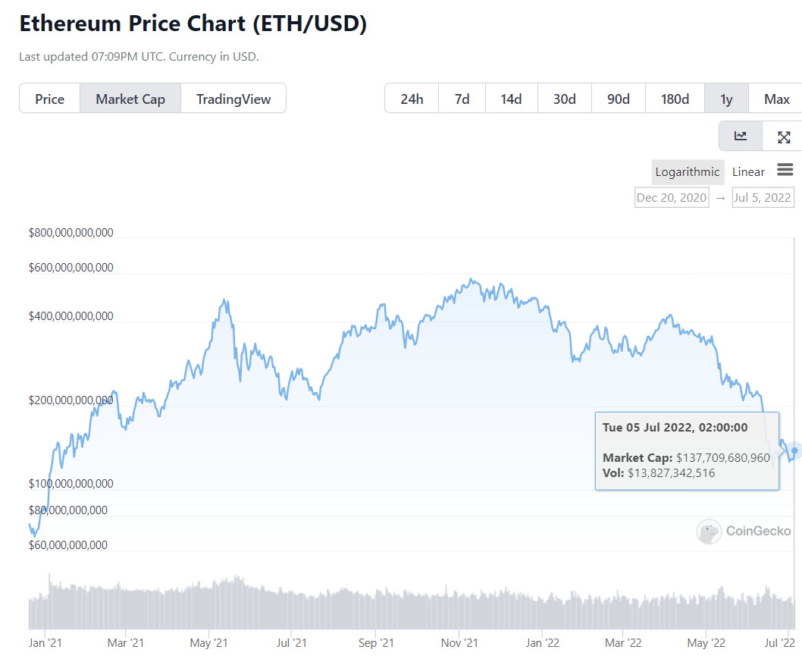
Intro:
„Blockchain“ is a technology.
„Cryptocurrency“ is an application.
A driving one, but
still just an application.

Slide 6
Definition of a blockchain
Public database
Consensus process of updating data (write, change)
Public: everybody can read from it, interact with it
Secure: Consensus is based on „trustless“ processes using cryptography
Nobody „owns“ the (big) blockchains, but there is a „governance“ process for them. Eg. Ethereum has pretty strict voting rules and is „steered“ mostly by developers and big ETH owners - https://ethereum.org/en/governance/

Slide 7
Core ideas of the blockchain
Anonymous
Public
Decentralized
Immutable
Safe
Trustless
With a grain of anarchy

Slide 8
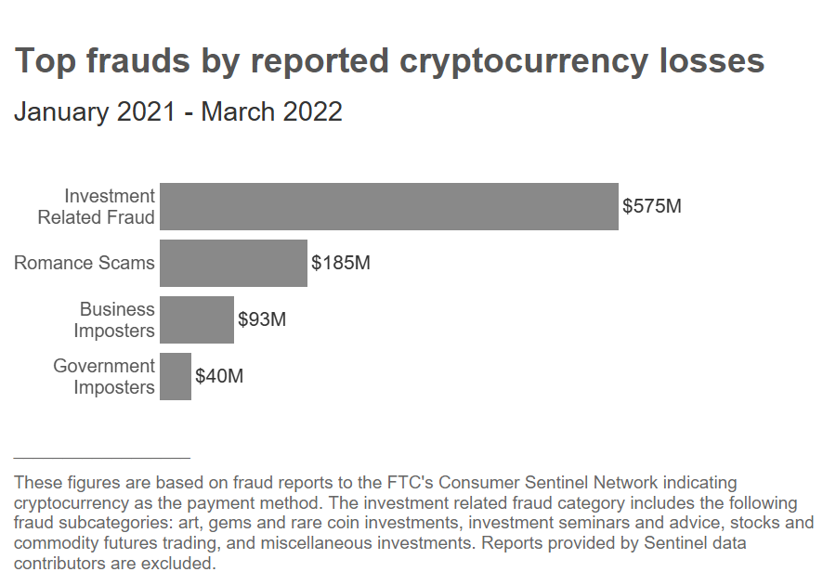
Core problem of the blockchains
https://www.ftc.gov/news-events/data-visualizations/data-spotlight/2022/06/reports-show-scammers-cashing-crypto-craze

Slide 9
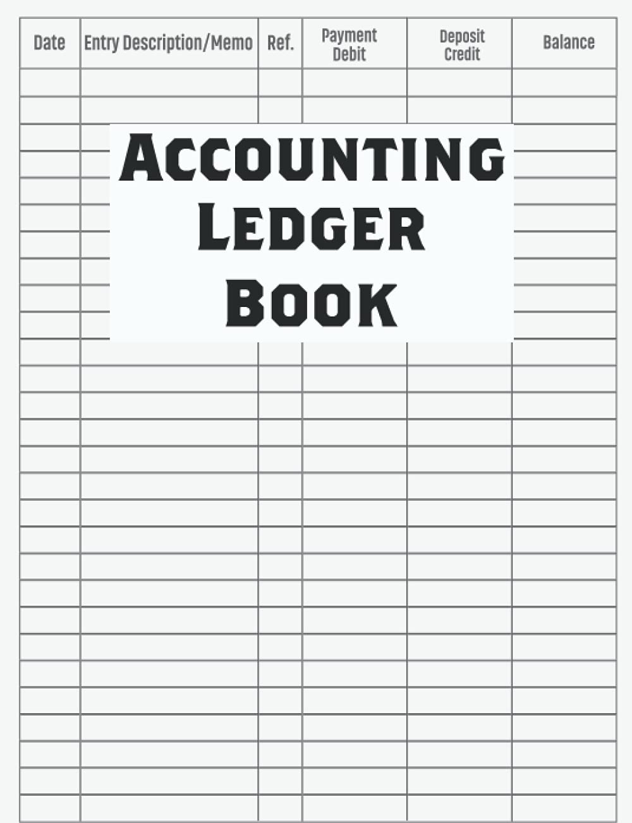
The lingo: just there, to confuse you!
Wallet
Ledger
Nodes
Mining
Coins
NFTs
Gas fee
Address (pointer) in the public database
A slightly different word for „blockchain database“
Member of blockchain infrastructure (Light/Full)
No, not „making“ coins, but validating transactions
Just entries in the blockchain ledger
Just entries in the blockchain ledger (tokens)
Users pay, nodes get some money for „mining“

Slide 10
Examples of big 5
Bitcoin
Ethereum (and side-chains based on it – Polygon, Metis, etc.)
Solana
Stable Coins (USDC, Tether – mostly based on Ethereum)
Cardano

Slide 11
What is the difference?
Commonly we speak of 3 generations of blockchain technology, see
https://www.ledger.com/academy/blockchain/web-3-the-three-blockchain-generations
Bitcoin is all about currency (and of course pure speculation and a social experiment) – we call it a generation 1 blockchain.
Ethereum is technology and feature driven (smart contracts), referred to as generation 2.
Cardano, Polkadot, Ethereum 2.0, etc. are scalability and technology driven updates of the generation 2 ideas, alas generation 3.

Slide 12
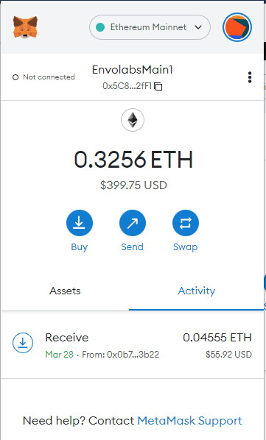
Ledger, Nodes and Wallets: ETH example
Wallet
App
0x589A…24F
Wallet Address
Node 1
Node 2
Node 3
Node n
EVM
EVM
EVM
EVM
Consensus
& Distribution
Logic
Ledger

Slide 13
Let‘s play „blockchain“
Proof-of-work: all nodes confirm
Proof-of-stake: nodes with „skin in the game“ confirm

Slide 14
Sustainability
Proof-of-work: bad
51% of the nodes must confirm the transaction
=> right now, that is over 2,700 nodes on ETH
Proof-of-stake: good
Only 3 nodes of thousands must confirm the transaction
=> dangerous, when the 3 are good buddies, thus the consensus is random

Slide 15
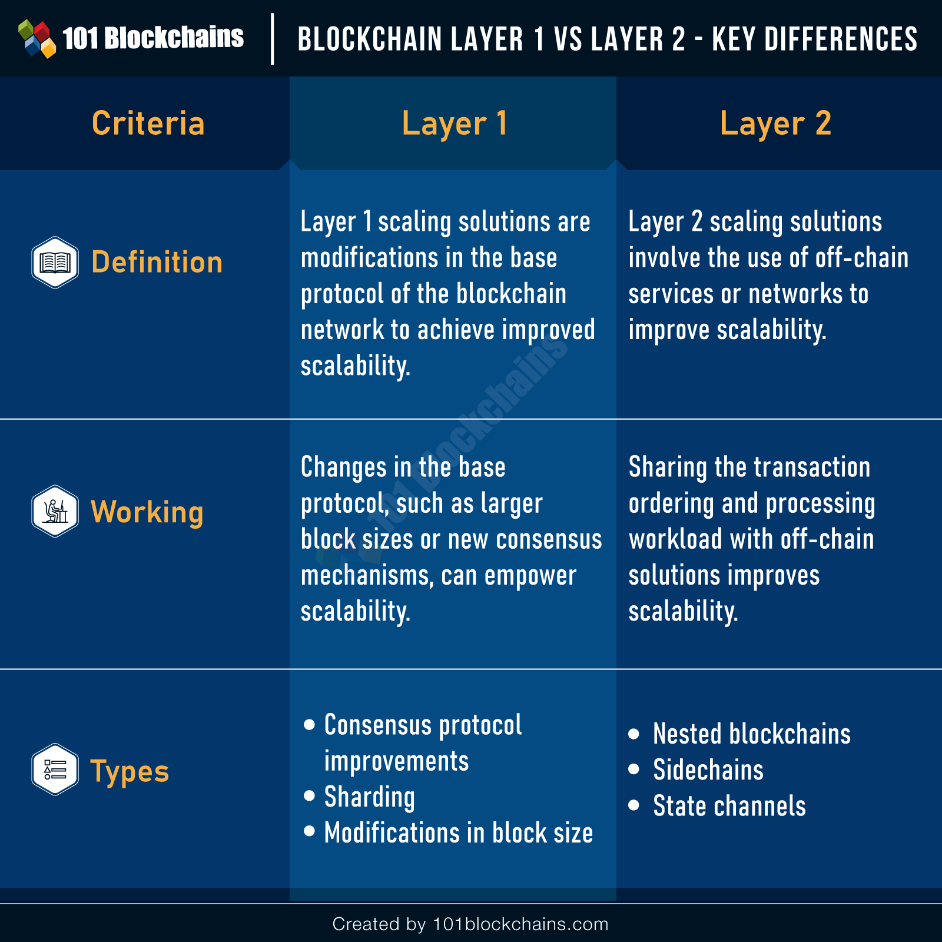
Layer-1 vs. Layer-2
Sidechain
Roll-ups
Channels
Layer-2 solutions are on Gen2 or Gen3 blockchains only, because they need smart contracts.

Slide 16
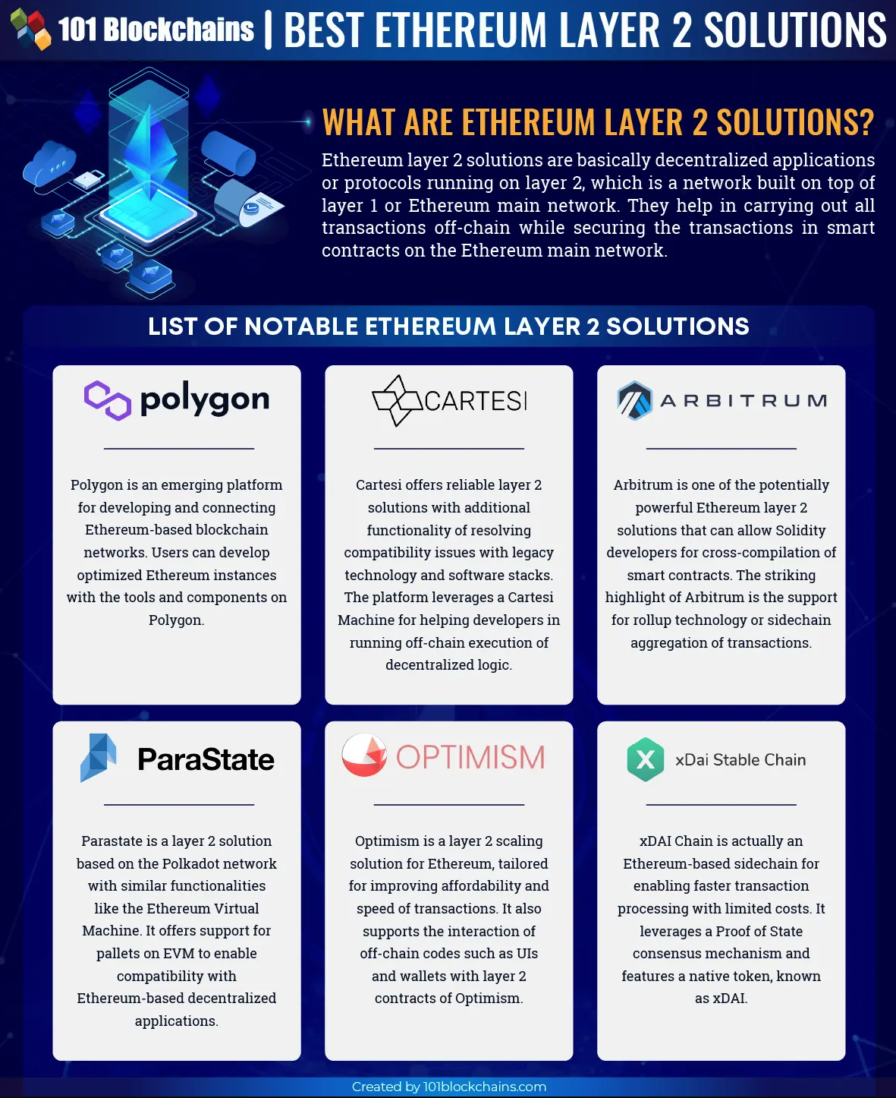
Layer-1 vs. Layer-2
A side-chain or roll-up is using (as the name suggests) the same technology, but summarizes transactions on the side, before submitting the whole collection of transactions into the main chain – summarized!

Slide 17
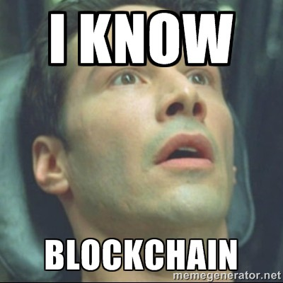

Slide 18
The financial game
ICO
Exchange
Smart contracts
Swap
Bridge
DeFi
Liquidity pool
Staking
Burning
Regulations

Slide 19
Smart contracts
The core difference between Bitcoin (Gen1) and Ethereum (and others Gen2 or Gen3 networks) are the smart contracts.
Smart contracts are compiled computer programs, submitted into the blockchain. They can not be updated, only „denounced“.
Smart contracts handle incoming requests with or without money involved, but each transaction causes computational work => gas fees!
In business blockchains (IBM, eg.) these gas fees can be ignored, also Layer-2 or Generation 3 blockchain solutions are much cheaper!

Slide 20
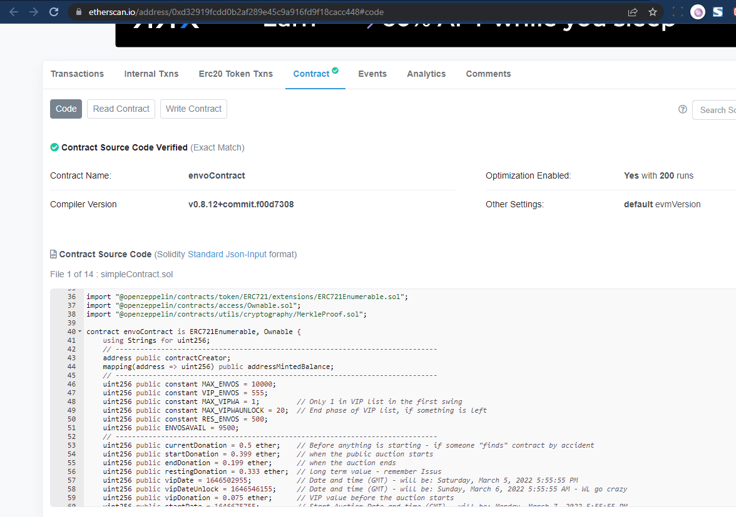

Slide 21
No smart contracts, no game!
Logical rules and triggers
If „keycard of Paula used on door, book 1 EUR from her wallet“
Publicly deployed (Open Source)
Hence „smart“: you can check and verify
Unchangeable
It can not be altered afterwards, hence „contract“
Logging
Interactions with smart contracts are all stored „on chain“: trustless!

Slide 22
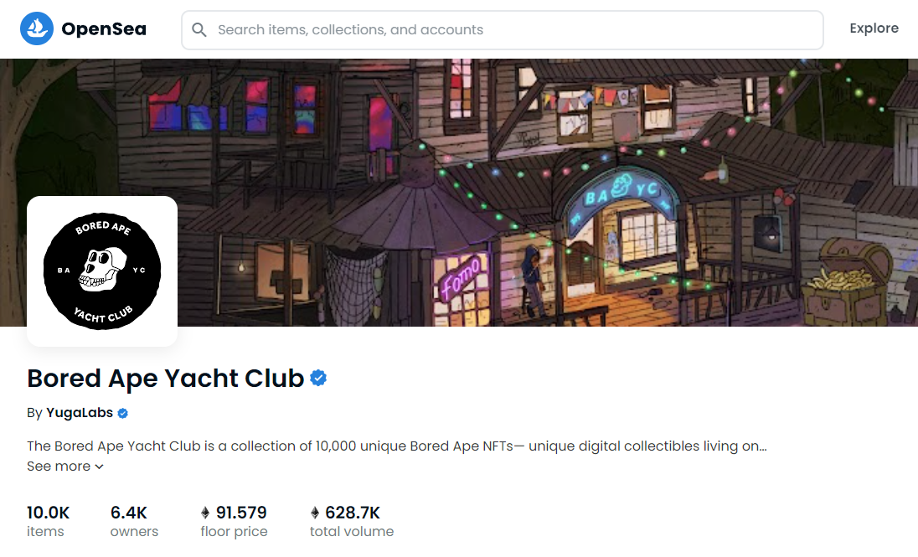
Smart contracts: NFT
An NFT is an „unchangeable“, unique entry: Non Fungible Token
The technical idea was, to certify files (eg. drivers license, stocks)
The crypto scene abused it for art: BAYC traded ca. 1.2 billion US$

Slide 23
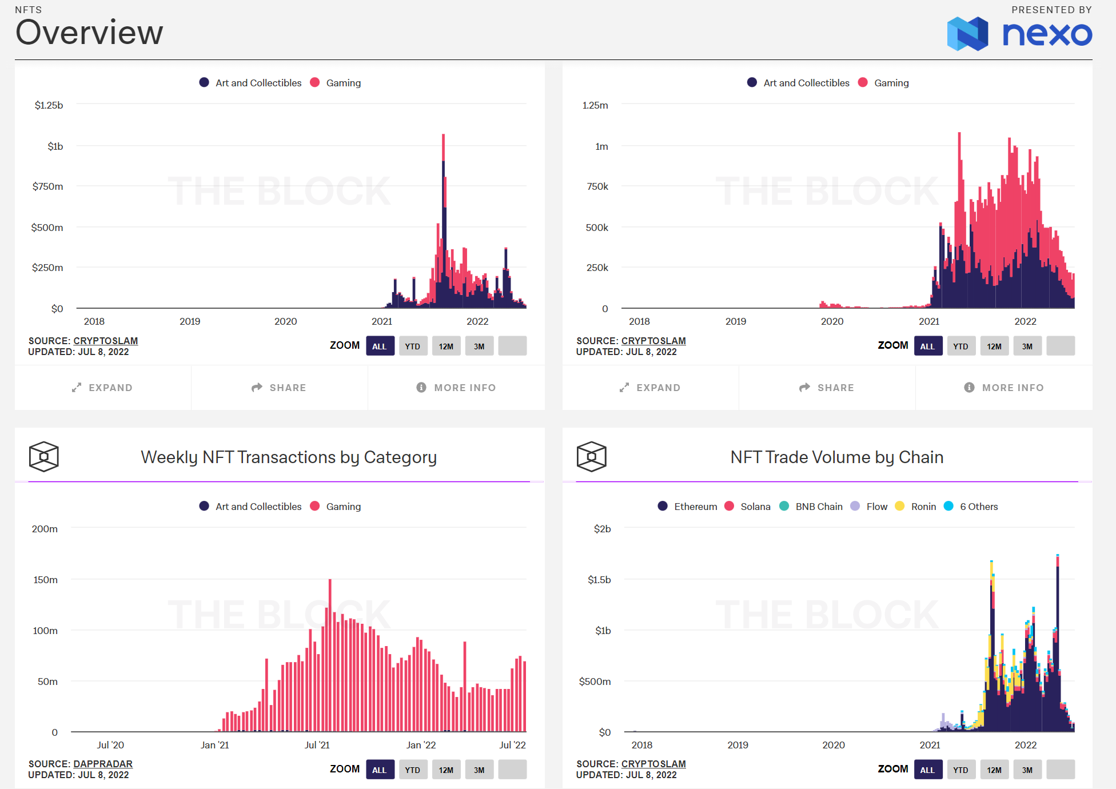
NFT: craziness
https://www.theblock.co/data/nft-non-fungible-tokens/nft-overview

Slide 24
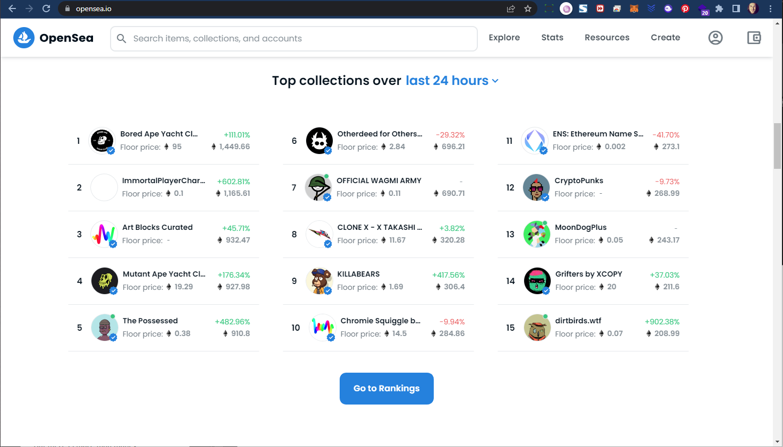
Smart contracts: NFT

Slide 25
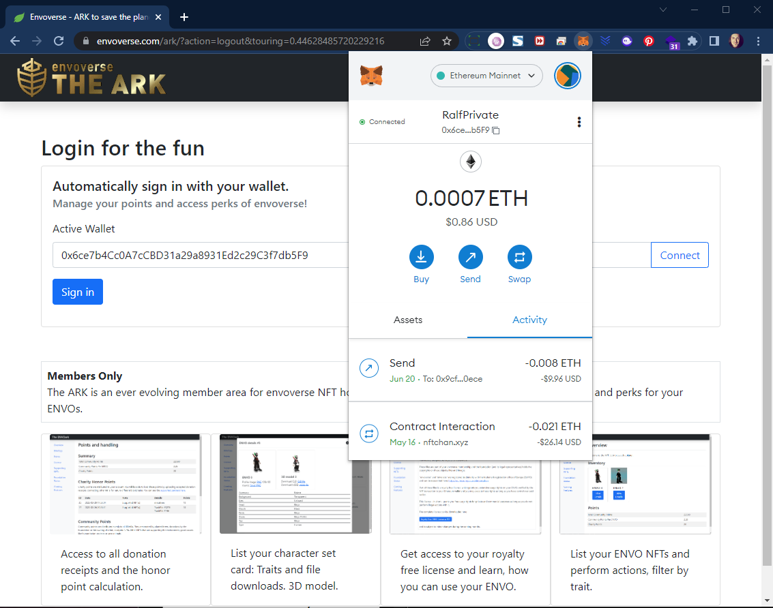

Slide 26
The financial game – a simplified story
Company GRQ wants to do an ICO (initial coin offering) as ERC-20 tokens and sets up a network of full nodes. 5 partners join in. They build a governance group.
They configure the servers together and define the initial smart contract to generate 100 coins. They put these 100 coins into the founders wallet (as unspend transactions or UTXO). Then they register their network with an exchange (eg. Kraken.com) and offer coins for fiat money.
A student (Paula) from the university of Münster identifies with Kraken.com and buys one coin for $100 with her credit card. She has to pay roughly 105 US$ ($5 is for fees). The transaction is „mined“ by the 5 full nodes and they get a split of the gas fees for that.
Paula gets 1 coin in her custodial wallet at Kraken. She can send that to her private wallet.
Kraken gets an exchange fee of around $2, the network gets around $3 for gas fees.
GRQ created a digital currency with a theoretical capitalization of $10,000. They still have 99 coins!

Slide 27
The financial game – pools, staking, etc.
Pooling: users can join anonymously to pool their money
Staking: users can lend their currency for interest (eg. proof-of-stake players might not have the necessary stakes themselves)
Swapping: Change coins in seconds
SPOT market: Peer-to-peer trading

Slide 28
The financial game – DeFi
Decentralized Financial platforms can, eg.:
Bridging crypto currencies from A to B
Quick lending (get a loan of $100,000 for 2 minutes)
Insurance
Stake money for interest
Asset management (eg. tokenize your stocks = NFT)

Slide 29
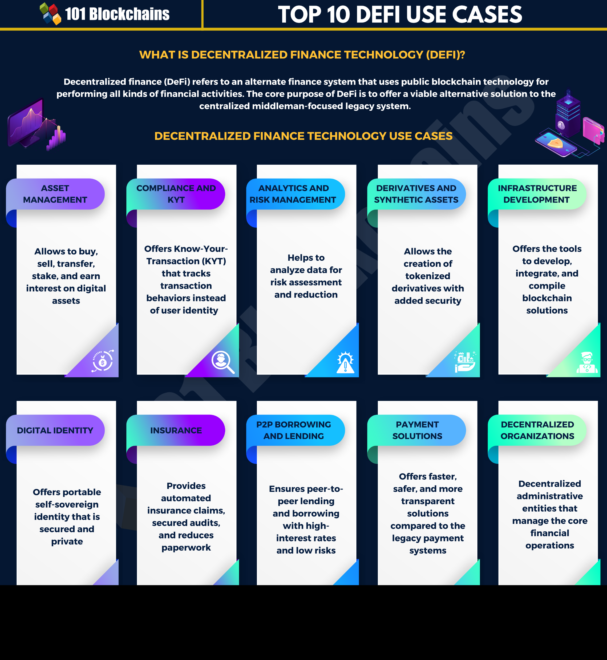

Slide 30
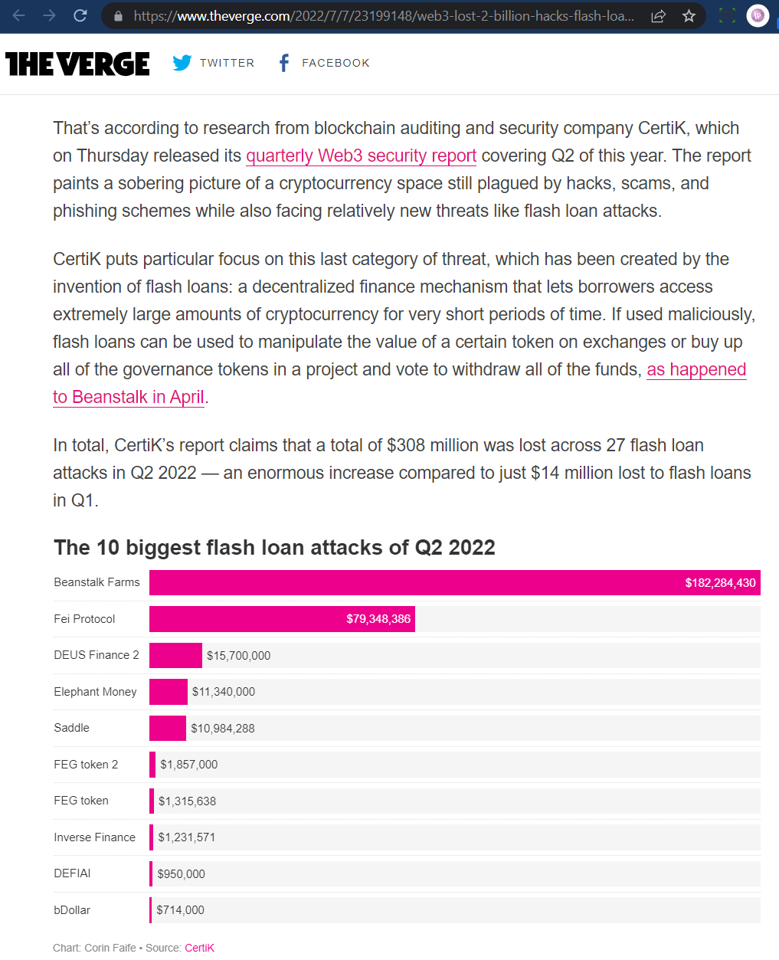

Slide 31
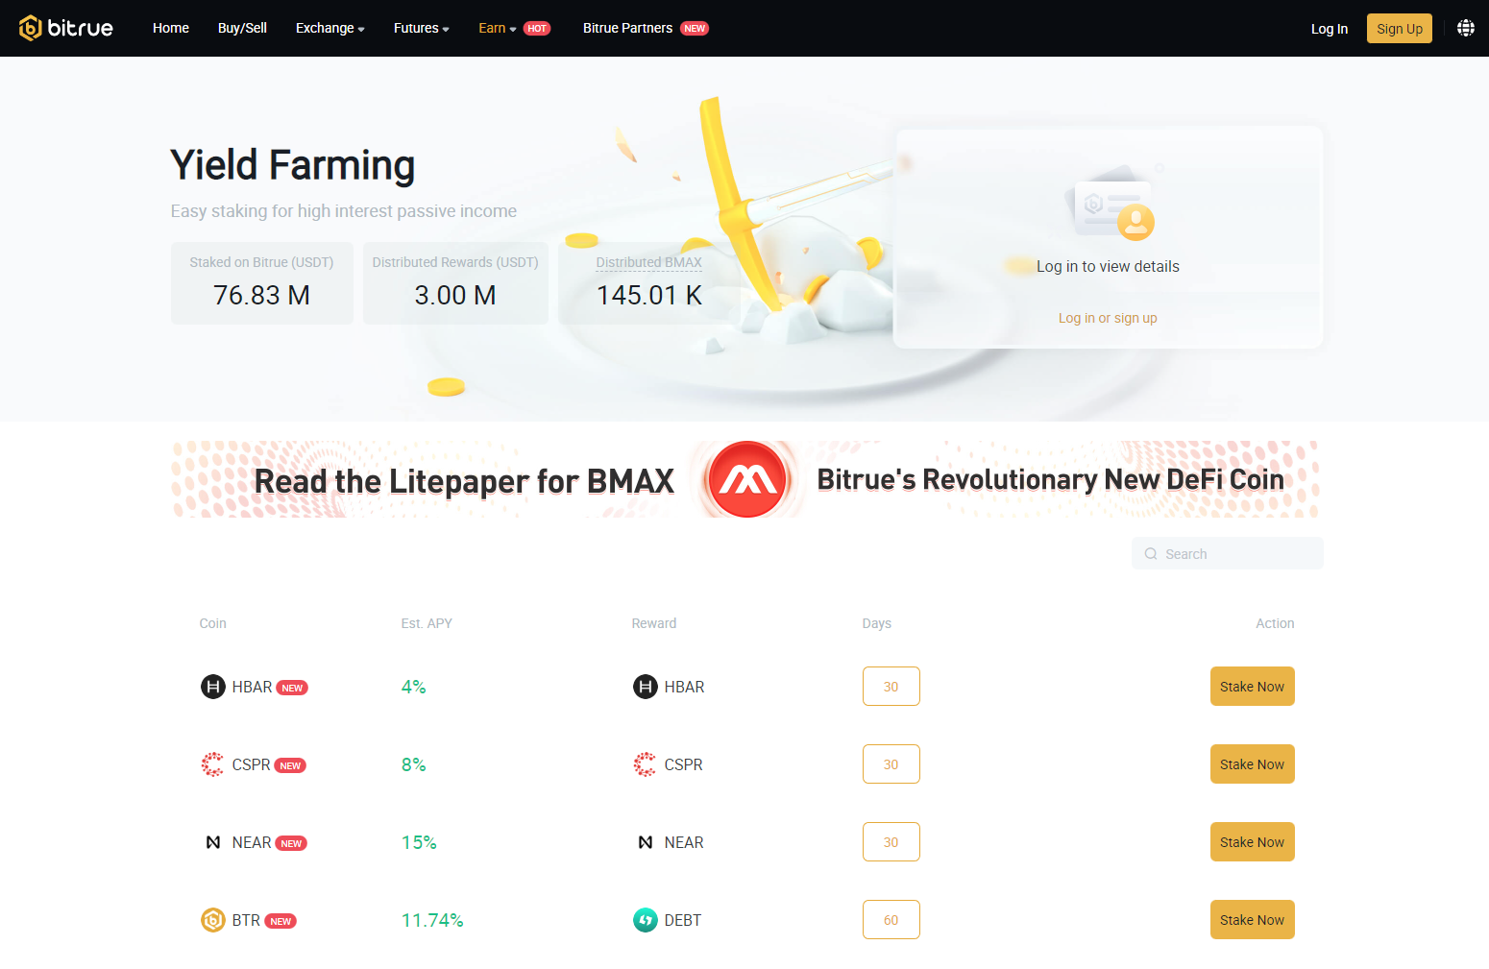

Slide 32
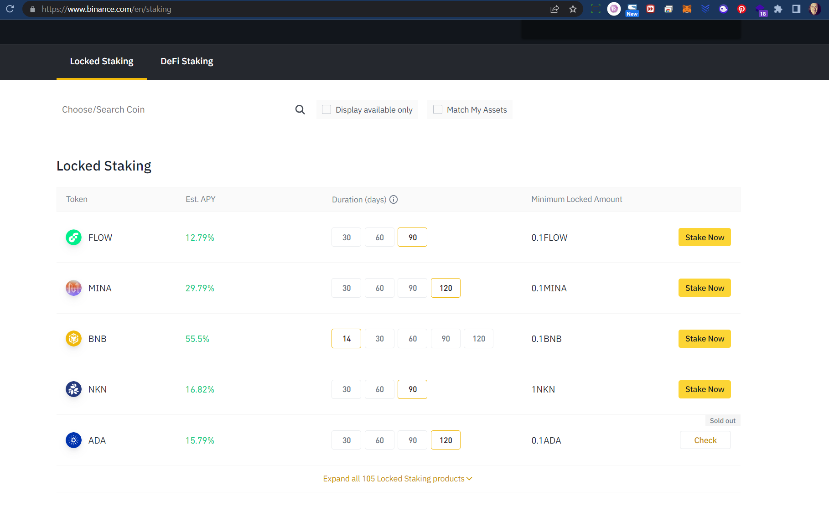

Slide 33
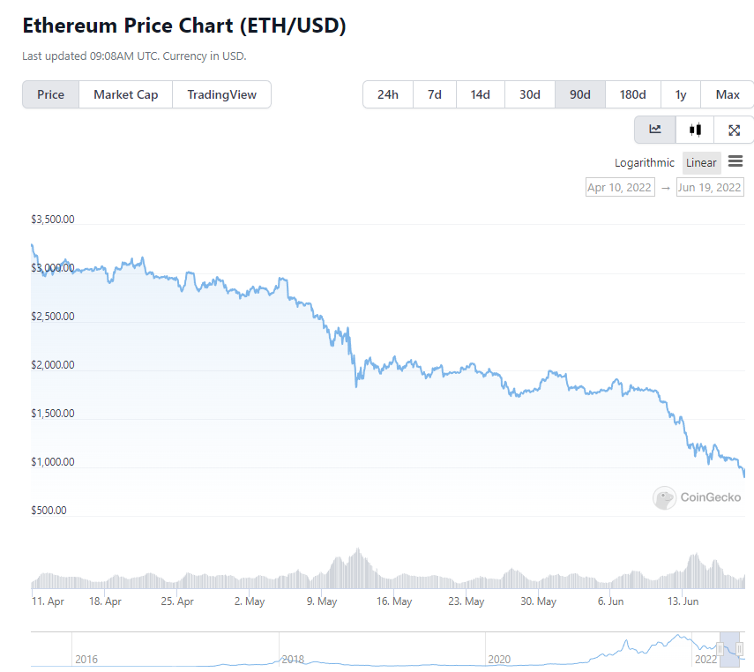
The financial game – pools, staking, etc.

Slide 35
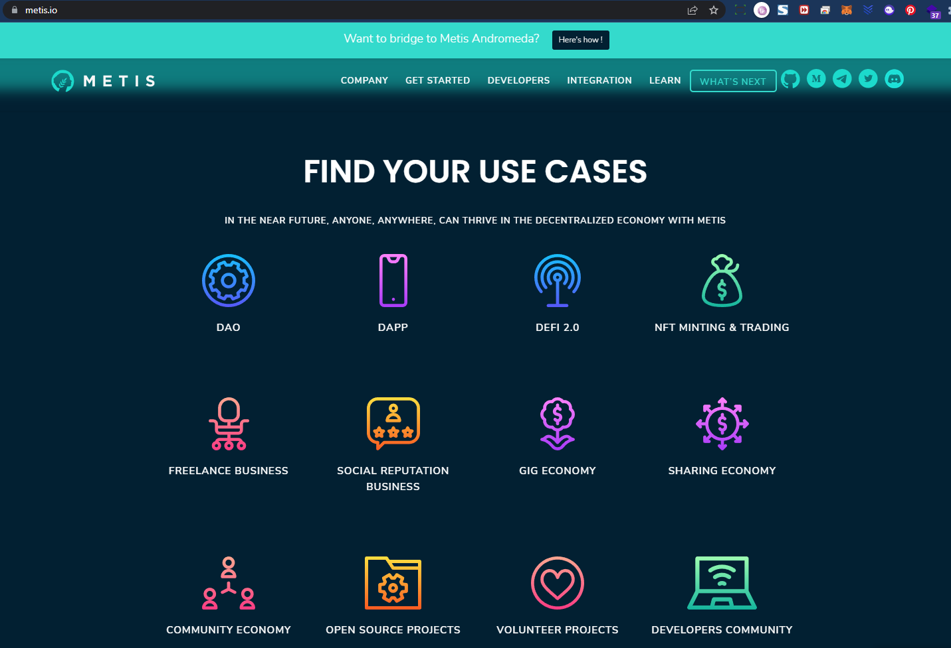
But there is more than money!

Slide 36
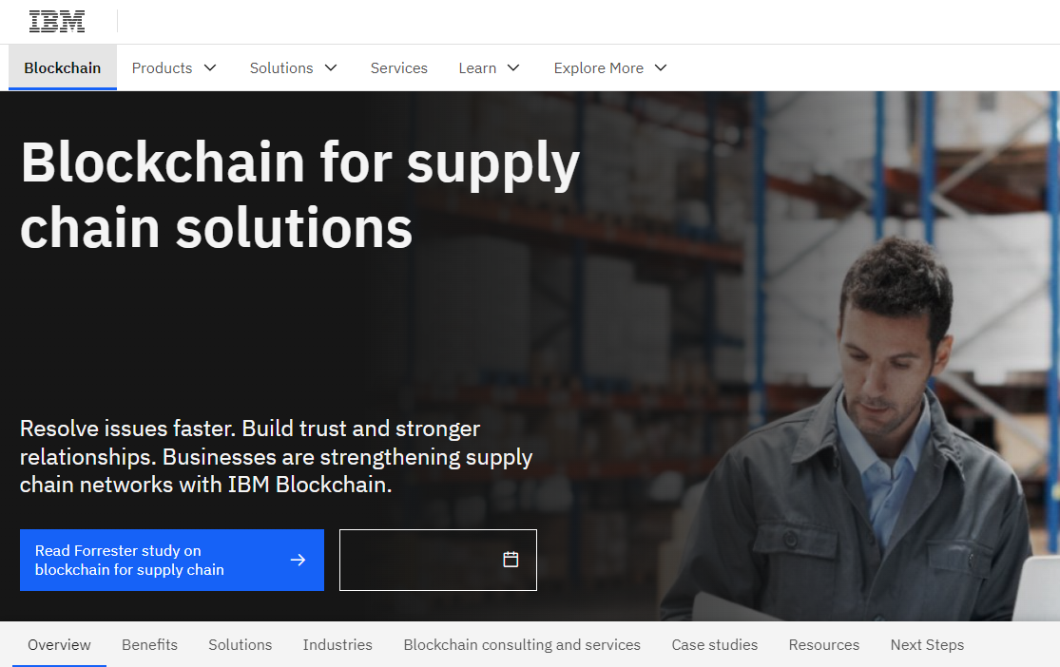
But there is more than money!

Slide 37
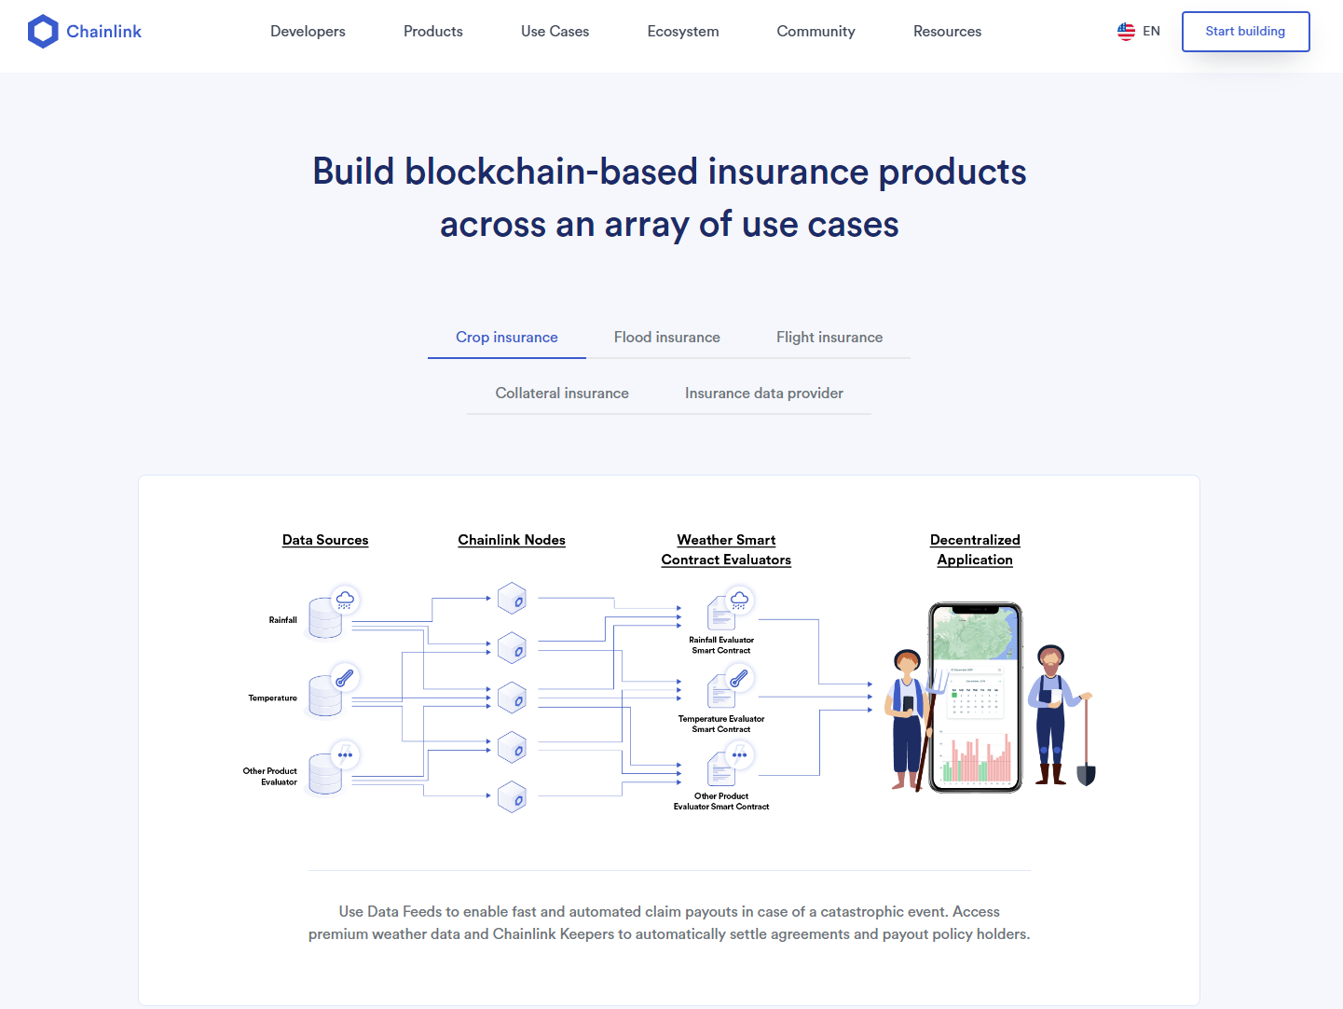
But there is more than money!

Slide 38
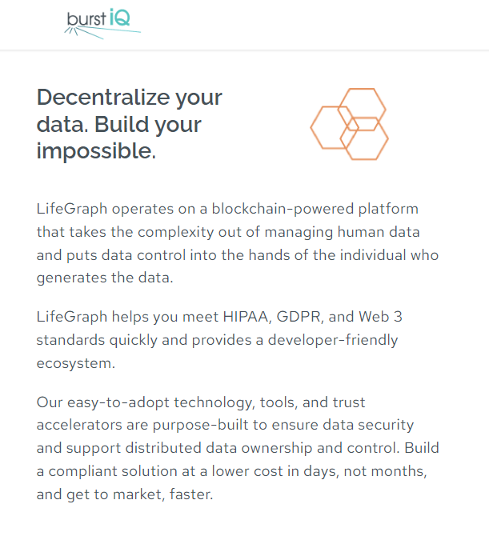
But there is more than money!

Slide 39
But there is more than money!
Blockchain technology is young
Blockchain technology got a bad reputation because of scams
But „blockchain ideas“ follow basic democratic principles
The true potential of the technology in combination with other ideas (AI, sensor gateways, storage needs or goverment needs) has still to be proven beyond the financial craze!
https://builtin.com/blockchain/blockchain-applications

Slide 40
Thank you!
Ralf

